Slide 1
The Scope of Software Engineering
Chapter 1

Slide 2
What is Software Engineering?
The application of Engineering Discipline to software development.
Software Engineering is the application of a Quantifiable, Disciplined, and Repeatable approach to the Design, Development, and Maintenance of Software Systems.
Engineering Discipline means developing software systems using a repeatable process that involves these four activities:
Understanding the problem to be addressed by the new system.
Designing and planning a software-based solution to the problem.
Building the solution within a predicted project lifecycle i.e., executing a project over a predetermined project schedule.
Ensuring that the resulting system is useful and reliable.
Notes:
Discipline: To train oneself to do something in a controlled and habitual way.

Slide 3
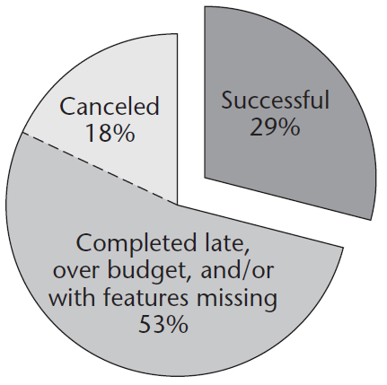
The “Software Development Crisis”
This figure describes the state of software development and that a large percentage of projects end in failure.
Over Budget, Late, or Missing Features. See Next Slide
See paper “Standish Group Chaos Report”.
Link to list of Failed IT Projects.
The goal of Software Engineering’s is to improve the percentage of successful projects.
How? By solving the many problems related to Programming in the Large.
Notes:
See the PDF “Standish Group Chaos Report” in supplemental materials.

Slide 4
What is a Software Project Failure?
Working systems delivered but delivered late and over budget.
Delivered after the date needed by, or promised to, the client.
Delivered at a cost greater than initially estimated to the client.
Systems delivered missing features needed by the client.
Missing features contracted for, and expected by, the client.
Systems delivered containing faults (bugs).
The system is delivered with serious faults requiring major (expensive) rework to make usable.
Systems not delivered at all.
A project whose execution is so badly managed that the project is abandoned before delivering rather than continue its funding.
Notes:
Reasonably late delivery is not really a failure and is more the norm in most projects.

Slide 5
We most need Software Engineering when Programming in the Large
See Self Driving Automobile on next slide.
When building a system…
That contain hundreds of thousands, even millions of lines of code.
That is built over the course of several months or years.
Containing many interacting, interdependent components.
That involves the combined contributions of many engineers and technicians (hardware and software).
The logistics of coordinating large projects from its start to a successful completion is a difficult challenge.
The challenge of planning and coordinating the efforts and contributions of the project’s team members.

Slide 6
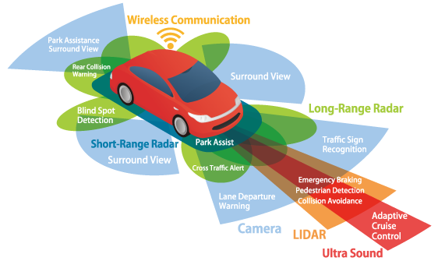
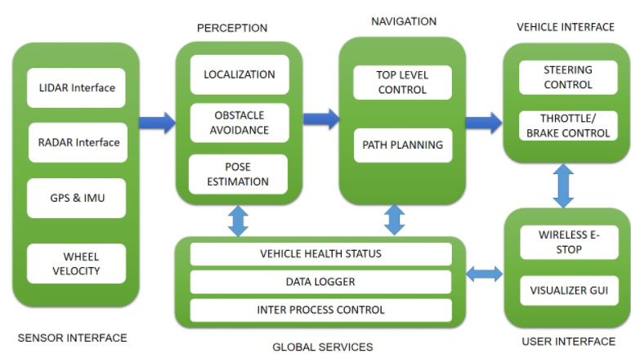
Systems Block Diagram for a Self-Driving Automobile
Notes:
The design of a SD automobile involves the contributions of hundreds of engineers, software, hardware, mechanical, etc., whose individual contributions must work together flawlessly.

Slide 7
Roles in Software Engineering
Client: The group (organization) with a problem to be solved.
Clients assume the costs of developing the system / solution.
Subject Matter Expert: The group with the technical and business knowledge needed to both describe the problem and evaluate the solution delivered by the Software Development Team.
Most times, the SME and Client are members of the same organization.
Sometimes SME and Developers are the same group e.g., startups.
Developers: The group who assumes responsibility for producing and delivering a solution to the client.
Users: The group who will utilize the solution.
Not necessarily the client e.g., a web service’s subscribers.

Slide 8
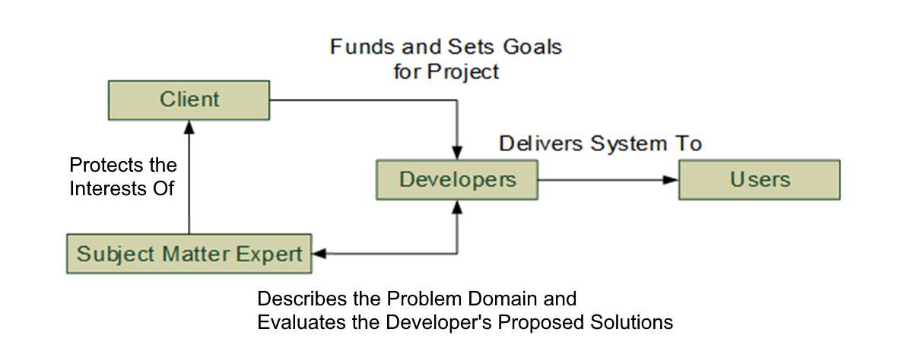
Software Engineering Roles
All four groups may belong to the same organization, or some groups may belong to separate organizations.
A corporation’s internal IT department providing solutions to problems within the organization.
The development team are contracted IT professionals hired by the client to produce and deliver the needed solution.
Notes:
The SME protects the interests of the Client

Slide 9
Application Categories
Custom Applications: A system / solution commissioned by an organization for a specific purpose.
A system that automates / supports some business process.
A system written to the specification of an insurance company’s specific claims processing process i.e., will not work for another insurance company with a different process.
Commercial Applications: A product to be sold to the public.
A desktop / console video game, word processor, etc.
A web service delivered to users through an App e.g., Spotify.

Slide 10
Software Engineering Terminology
System: A collection of software and hardware services that when combined solves a problem, provides a service, etc.
The Self-Driving Automobile mentioned earlier.
Application: Individual software programs (executables) that operate stand-alone or contributes to the overall system.
Systems are often composed of many applications that execute independently and communicate over a network or other IPC.
Some of the system’s applications are custom written software.
Other applications may be commercial or open-source products e.g., a database server.
Notes:
IPC: Inter-Process Communication
Most systems use a database management system (DBMS) which is provided by a vendor (MS SQL Server, MySQL, many others)

Slide 11
Software Engineering Terminology
Features: Statements that informally categorize and describe the services to be delivered / implemented by a system.
Features are informal statements that describe the information the system maintains or services the system performs.
Features lack the detail needed to bring a project to a successful conclusion.
Features are the basis for organizing requirements gathering activities.
Requirements: The mechanism used to formally describe the features to be delivered with the system.
Requirements are detailed and specific descriptions of the system.
Requirements are gathered from the client / SME and formally recorded in one or more documents.
The system’s requirements defines the scope of the project i.e., what the development team is expected to deliver to the client.
Notes:
The relationship between features and requirements is a parent-child hierarchy. Each requirements expands on a specific feature. If Customer Management is a feature, there are requirements describing how customers register is a child of the CM feature.
In a poorly managed software project, development starts with only the system features and lacks the detailed requirements needed to successfully define, plan, and execute the project i.e. deliver the system.

Slide 12
Software Engineering Terminology
Problem Domain: Knowledge of the entities (things) and operations (services) that make up the system’s domain.
Knowledge needed by the development team to build a system that is useful to the client and users.
Two systems that share the same problem domain will share many features and requirements e.g., two implementations of an e-commerce site share the same problem domain but will implement their features differently.
Systems from different problem domains will have little in common.
Before the dev team can successfully build a system, they must become mini-experts in the concepts, roles, terminology, business rules, operations and other aspects of the system’s problem domain.
Notes:
Examples from Ecommerce Problem Domain: Entities are Customer, Product, Address, others. Operations are Site Registration, Product Browsing, Order Checkout, others.
1. Before a dev team can successfully build a Self Driving Car, they must become mini-experts in the control and operation of automotive sensor, dynamics (physics) of the moving vehicle, path finding / planning, automotive control, etc.

Slide 13
Software Engineering Without Discipline
What is building software systems without discipline?
The book describes the “Code and Fix Development Model” where code is written without planning or organization.
See next slide…
Code and Fix can work for small projects involving a few developers.
What are the common types of project failures caused by an undisciplined approach to building systems?
Systems delivered late and over budget, or even canceled.
Systems delivered with missing features, bugs, and other defects that are addressed by never-ending releases (versions).

Slide 14
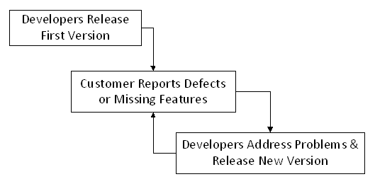
Code & Fix Software Development
Code & Fix builds a system without planning or organization.
Developers build an initial release of the software which they “feel” is complete and release to the client who responds with defects.
The developers address the defects and release a new version.
Back and forth the system is modified, re-released, evaluated until the client is satisfied with the current version or refuses to pay for further development.

Slide 15
Four Problems / Characteristics of Code & Fix Development
Development (coding) begins without a precise understanding of what the client wants / needs.
No clear understanding of the features to be delivered.
Without taking time to interview and understand the client’s problem and build models that describe the proposed solution.
There is no clear agreement of when the project is finished.
No understanding of much time and budget will be needed to complete the project to the client’s satisfaction.
Nothing keeps the client from adding or changing features extending the effort needed to complete the system.

Slide 16
Four Characteristics of Code & Fix Development
C&F results in poor relations between the client and developers.
The client is continuously identifying problems and waiting for fixed versions.
Clients are not required to consider precisely what they need from the system i.e., are requesting one feature, but really need another.
Poorly designed and unmaintainable implementation (code).
Continuous change and refactoring of the system’s design often results in an implementation that lacks cohesion and is tightly coupled.
Changes to the code often result in producing new bugs in unrelated features i.e., spaghetti code.

Slide 17
Software Engineering with Discipline
Discipline in software development means allocating the resources¹ needed to understand the system before building.
Understanding the problem (Gather and Record Requirements).
Planning the project’s execution (Scheduling and Budgeting).
Designing a solution to the problem (Analysis and Design).
Executing the solution (Construction and Unit Testing).
Verifying the system meets requirements (Integration Testing).
With a disciplined approach to software development, our project are more likely to be …
Delivered on time and on budget.
Delivered with all the agreed upon features.
Delivered free of faults / defects.
Notes:
The ultimate software development process is useless if the development does not utilize it. However, utilizing the process require discipline on the part of the development team. Testing and re-testing software components. Building and maintaining the documents that describe requirements, analysis, design, testing, schedule, etc.
1. Resources include the scheduling the time needed by the team to build a solid understanding of the problem domain. Increased schedule means increased budget (money).

Slide 18
Delivered On-Time and On-Budget
A successful software engineering project starts off with, and consistently updates its Project Schedule.
The schedule starts with milestones & delivery dates.
A fairly accurate (but never perfect) estimation of the resources (time, budget, personnel) needed to deliver the project when needed.
Milestones: Important accomplishments to be completed between the project’s start and delivery dates. Each milestone is associated with an estimated completion date.
A disciplined team will monitor the project’s progress towards completing the system throughout the project’s lifecycle.
The team can use milestones to determine if the project is behind schedule and take actions to correct the problems well before the project’s delivery date.

Slide 19
Delivered with the Agreed Upon Features
Features, requirements, and other techniques are a means of recording what the system will need to know and do.
Using this information, the development team can determine whether the delivered system is both complete and correct.
Complete in that the delivered system provides all the agreed upon services (between client and development team).
Correct in that the service’s implementation is useful to the client.
Determining this level of detail requires a disciplined approach to describing and constructing the System’s Requirements.
Requirements must be sufficiently detailed so that system’s features are unambiguously described and can be verified by both parties upon delivery¹.
Notes:
1. The gathering requirements that completely and correctly describes the entire system can be challenging. It might involve collecting and organizing hundreds to thousands of individual requirements (statements) depending on the size and complexity of the system being developed.

Slide 20
Delivered Free of Defects
Defects might be programming errors.
An incorrectly implemented algorithm or business rule.
Defects might be missing or incorrectly implemented features.
An incorrect understanding of how the system needs to behave.
Defects are identified by exercising / testing the system.
A disciplined approach is one where testing is carried out throughout the project lifecycle.
Modern software development allows the SME and client to test the partially completed system throughout in the project.

Slide 21
Proper Testing Requires Engineering Discipline
Best Practices in SW Eng. recommends two types of testing:
Unit Testing: Testing of individual classes and class methods.
Unit testing determines whether a class is correctly implemented.
Unit testing is performed by the software developer and considered a job responsibility of the developer.
Integration Testing: Testing of the system as an integrated whole.
Testing of the assembled system to determine whether features are correctly implemented.
Integration testing is performed by a separate Quality Assurance team before the system is delivered.
Integration Testing is also performed by the developers after each partial delivery of the system i.e., Incremental Development.

Slide 22
How does SE help to ensure the successful delivery of a project to the customer?
Software Engineering provides techniques used to guide the design, construction, testing, and delivery of the system.
Techniques that describe how to capture the customer’s vision i.e., what they need and/or desire from the system.
Techniques that translate the vision into requirements with identifiers that can be tracked throughout the project lifecycle.
Techniques for assuring that the requirements are correctly implemented and delivered to the customer.
Techniques that help with construction, testing, documenting, resource planning, and many other project-related activities.
Techniques used to coordinate and assign activities among the members of the development team.

Slide 23
The Software Development Lifecycle (SDLC)
“Lifecycle” is the generic name given to the overall effort of building a system from start to finish.
Project start and completion dates, and much, much more.
Lifecycle provides the conceptual framework in which we can discuss the process¹ of building of the software system.
A Process’s Lifecycle is divided into phases that describe…
The Activities performed by the development team throughout the project lifecycle.
The Artifacts (document, designs, etc.) that are produced by the execution of an activity.
Generic Lifecycle Phases: Requirements, Analysis, Design, Implementation, Integration Testing, & Delivery.
Notes:
1. The activities the team performs between the beginning and end of the project that leads to a successful delivery of the system to the client.

Slide 24
Example of a Software Development Process
1000
2000
3000
4000
Project Initiation
Requirements
Logical Design
Physical Design
Definition
1010 Project Background
2010 High Level
3010 Detailed Analysis of
4010 Technical Overview/
1020 Project Objectives
Requirements
Requirements
Architecture Blueprint
1030 Project Scope
2020 Alternative Solutions
3020 Process Flows
4020 Deviation from Standards
1040 Project Benefits
3030 Detailed Assumptions
4030 Detailed System Design
1050 Project Approach
3040 Business Areas Impacted
4040 IT Project Plan
1060 Project Deliverables
3050 Affected IT Systems
4060 Business & Technical
1070 Project Assumptions &
3060 Dependencies
Discussion And Walkthrough
Constraints
3070 Considerations
4090 Peer Review
3080 Proof Of Concept/Prototype
4100 Phase 4000 Sign Off
3090 Peer Review
3095 Project Plan & Cost
3100 Phase 3000 Sign Off
8000
7000
6000
5000
Installation
Production
Testing
Construction & Unit
/ Post-Installation
Preparation
Testing
8010 Hardware/Software Change
7010 Training Notification & Plan
6010 Prepare Integration Test Plan
5010 Affected Elements Changed
Request
(Business Owner)
6020 Prepare System Test Plan
5020 Prepare Unit Test Plans
8020 Post Implementation Review
7020 Change Control Package
6030 Prepare Acceptance /
5030 Peer Review
7030 Business Continuity
Regression Test Plan
5040 Execute Unit Test Plans
Planning
6040 Peer Review
5100 Phase 5000 Sign Off
7040 Implementation Plan
6050 Execute Integration Test Plan
7050 Installation Contingency
6060 Execute System Test Plan
Plan (Back Out/Recovery)
6070 Execute Acceptance /
7060 Operations Turn Over
Regression Test Plan
Package
6100 Phase 6000 Sign Off
7070 Phase 7000 Sign Off
Notes:
Phases and the Activities & Artifacts delivered within each phase.

Slide 25
The Phases of the Generic Project Lifecycle
Requirements: The development team builds an understanding of the system’s responsibilities.
Understand the problem the client needs to have solved.
Identify what the system needs to ‘know’ and needs to ‘do’.
Gathering and Recording features and requirements from the SMEs.
See next slide.
Analysis: The team builds an in-depth understanding of the problem domain but not (necessarily) the software design.
Build an understanding of the system’s problem domain.
Develop an in-depth understanding of the things known and done.
Gather any additional information needed to design the system¹.
Identify questions / issues / risks not addressed by the requirements.
Notes:
1. Additional information includes required performance, constraints on technologies that can be used to construct the system, others.

Slide 26
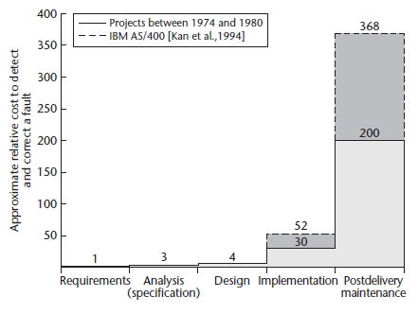
The Importance of Understanding the System’s Requirements
This figure illustrates the cost of fixing a missing or incorrectly implemented feature throughout the project’s lifecycle.
A missing or incorrect requirement found early in the project lifecycle are easily (inexpensively) corrected.
A missing or incorrect requirement that has been coded and delivered to the client is very expensive to correct.
So, it is important to ensure that incorrect requirements are not coded and delivered.
Notes:
A problem or missing feature discovered early in the lifecycle may only require an updated document or model to correct. However, code has been written and integrated with the larger system, removing the bug or adding the missing feature becomes far more expensive. Ultimately if the faulty system is delivered to the customer, the cost can include recalls, lawsuits, and damaged customer relations.

Slide 27
The Phases of the Generic Project Lifecycle
Design: Build models of the system’s software structure.
Decompose the system into discrete software components¹ each with a specific set of unique capabilities (methods and attributes).
Identify how components interact / interface with their peers.
Document the software design as Unified Modeling Language (UML) models (diagrams).
Implementation: Construct the system according to the design.
Build, integrate (combine), and test the HW and SW Components.
In terms of software implementation …
Code and test the software components identified in the design.
Integrate and test the components into a functioning system while fixing any faults identified by the testing activities.
Notes:
1. Components and Classes.

Slide 28
The Phases of the Generic Project Lifecycle
Integration Testing: After implementation and before delivery, the system is thoroughly tested to discover any defects that exist after the development team has ‘finished coding’.
Formal activities that involves a separate Quality Assurance Team responsible for testing for and tracking defects.
Delivery: The process of delivering and installing the system in its production environment.
Configuring servers, databases, network infrastructure, and tasks required by the system to operate.
Making the system available to its users.

Slide 29
Umbrella Activities
Each phase of a SDLC process defines specific activities that are executed by the development team in a specific phase.
An Umbrella Activity is an activity that is executed by the development team throughout the Project Lifecycle.
Independent of the phase the project is currently executing.

Slide 30
Scheduling and Project Management are Umbrella Activities
The project schedule is built early in the project and is updated and monitored throughout the project lifecycle.
The project schedule is continuously refined as the team forms a deeper understanding of the problem domain and the work needed.
The schedule is updated / refined as unforeseen events occur during the project’s execution.
It is important to continuously monitor the project’s progress and determine ASAP if the schedule needs revision.
For example, if the expected delivery date is not going to be met.
Address problems with additional budgeting, customer expectations, and others issues.

Slide 31
Testing is an Umbrella Activity
Testing of the system as it is constructed is also carried out throughout project lifecycle.
Unit Testing is performed during implementation phase.
With an Incremental Process, Integration Testing is performed at the end of each development iteration i.e. every 3-4 weeks.
It is important that ‘bugs’ in the system be detected and corrected as soon as they are introduced.
Much like faulty requirements, the cost of fixing a bug rises dramatically the longer the bug remains undetected and new features are written around it.
Unit and Incremental Testing’s purpose is to identify bugs and regressions introduced into the system by on-going development.

Slide 32
Documentation is an Umbrella Activity
Executing each phase of the generic lifecycle results in the production of (potentially) many documents (aka artifacts).
Each phase’s artifacts provide the information needed to execute the next phase.
Requirements are needed to execute analysis.
Producing and maintaining project documents is often considered a tedious and unrewarding activity but…
As the project progresses, the team’s understanding of domain, requirements, analysis, etc. are continuously evolving.
So, the documents should be updated with this new information.

Slide 33
Importance of Maintaining Documentation
Phases: Each phase of a project’s execution relies on the documents produced by the previous phases.
Creating and maintaining detailed documentation ensures that the next phases will be complete and correct.
Continuity: Software engineers often leave taking their knowledge of the problem domain and systems design with them.
Documentation is a means of maintaining this information within the organization.
On-Boarding: When new team members join the project, they can rely on detailed documentation to aid in their swift and productive integration with the team.

Slide 34
Importance of Maintaining Documentation
Integration Testing is executed by the QA team who needs requirement documents, use cases, and other design documents to produce integration test scenarios that are complete and correct.
Future extensions and bug fixes might be carried out years after the completion of a successful system.
It is seldom the case that the original development team will be assigned these tasks.
Complete and up-to-date documentation is often the only means of communicating the requirements, analysis and design, and other information needed to maintain the system.
Notes:
QA: Quality Assurance

